Slide 1
Automate Daily Data Entry

Slide 2
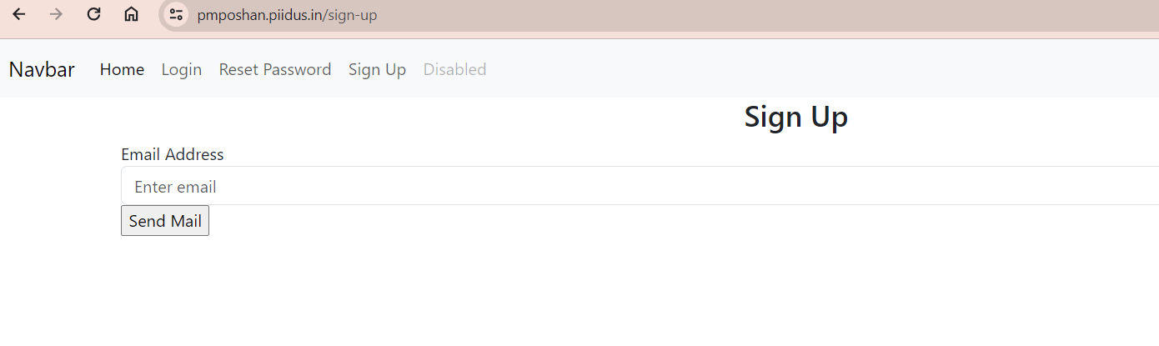
SIGNUP 1st ::
Enter Your email id and click
2nd ::
Check Your mail inbox/spam for otp

Slide 3
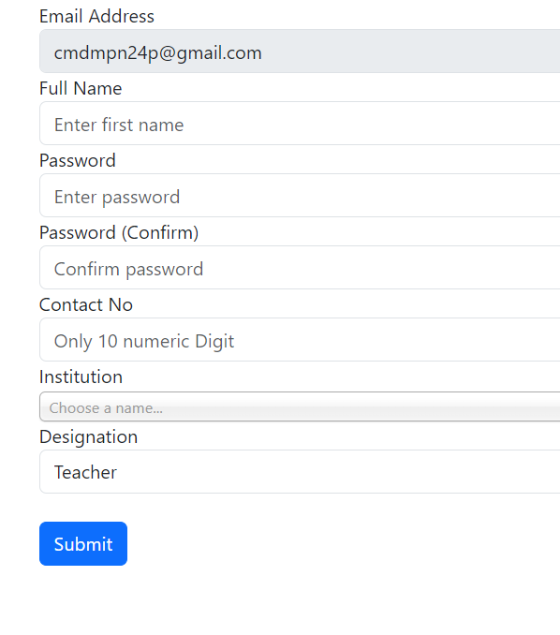
Fill all the Details
Password must be 8digit and
don’t share to anyone
Please search Schools Name

Slide 4
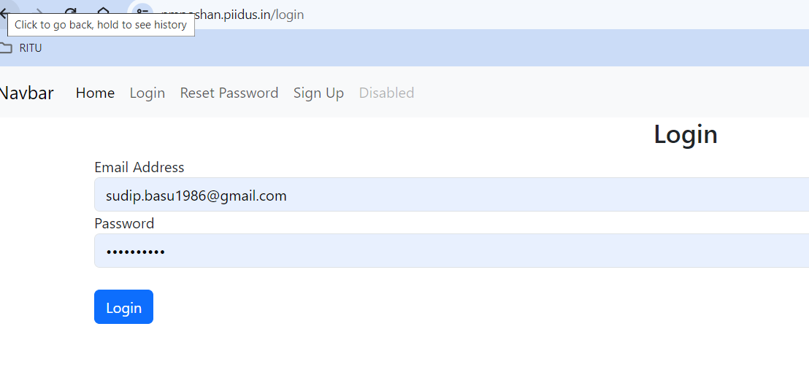
After successful signup
Now log in with your email-password

Slide 5
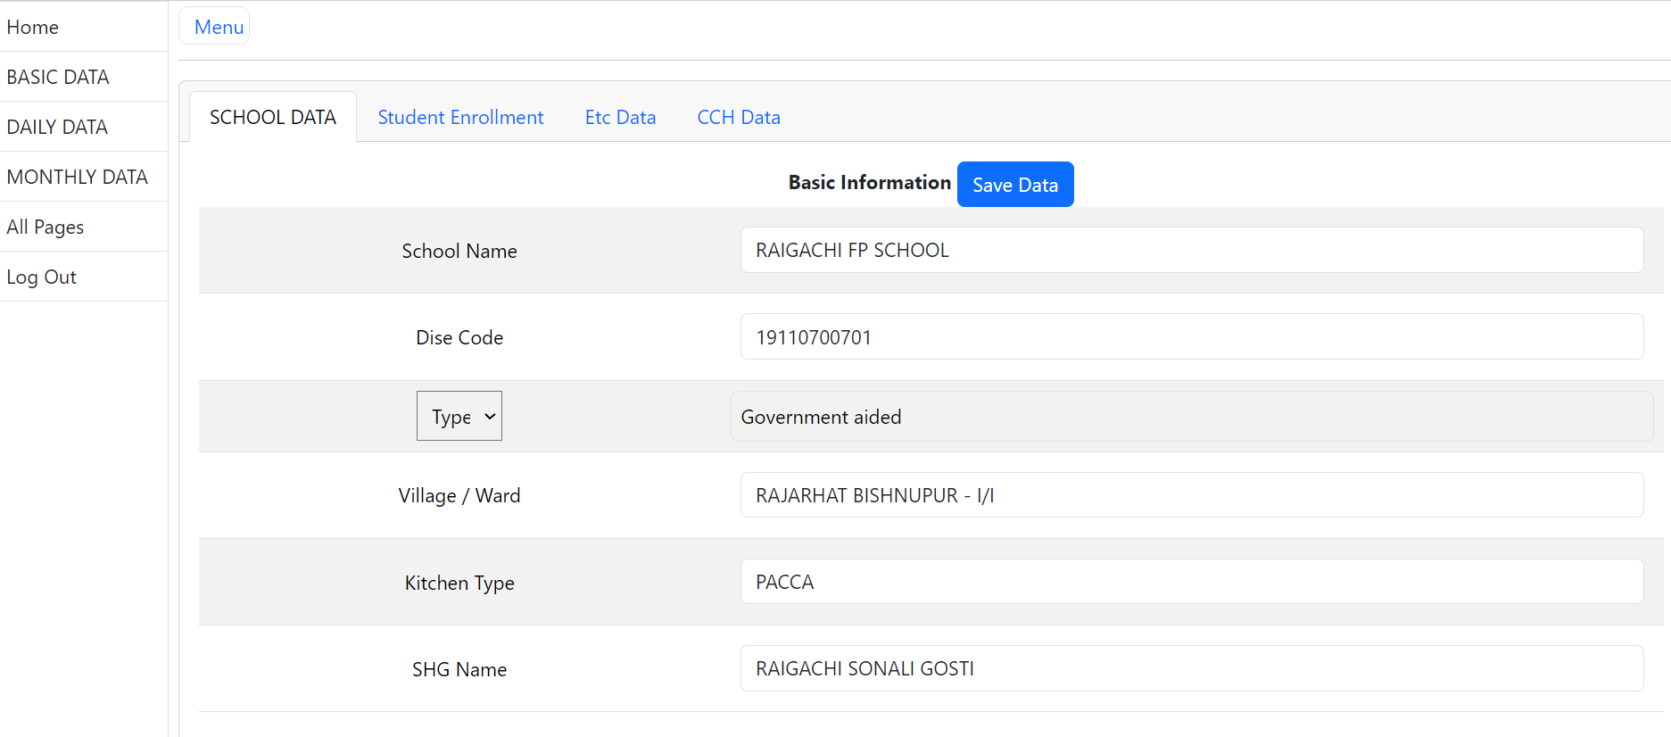
After Login Go to Dashboard Now Submit All data must CCH data

Slide 6
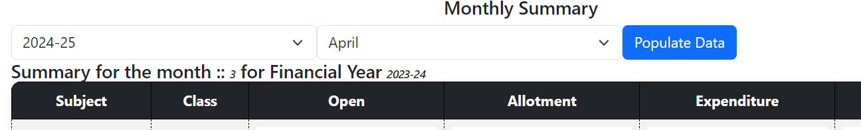
Now Go to Monthly data
First Search last Month also check Financial year and click Populate Data
Must Check

Slide 7
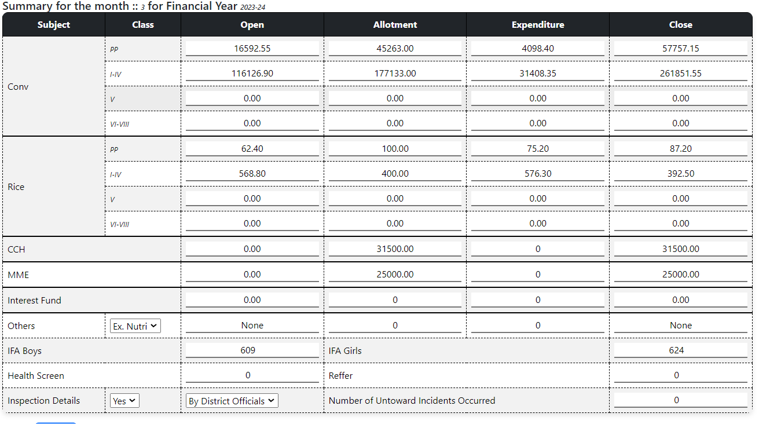
Only input last month closing – allotment in Open Column Then Freeze

Slide 8
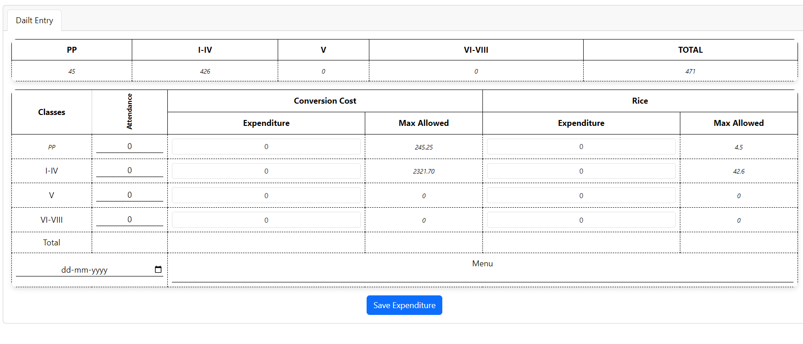
Daily Entry

Slide 9
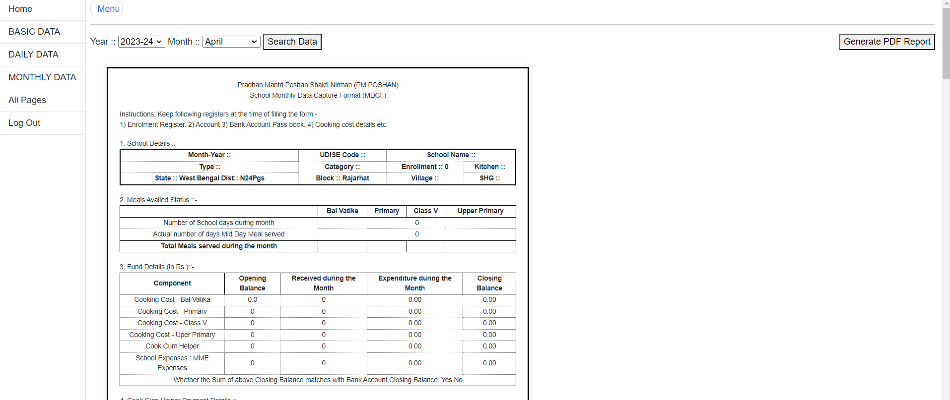
Search data for month
After Month End Freeze the data and generate Pdf

